Slide 1
IEEE Power & Energy Society
Vision 2021
Presenter Name & Title Date

Slide 2
The World’s Largest Professional Association Advancing Technology for Humanity
Global Reach
Technical Breadth
Social Impact
422,000+ Members
160+ Countries
123,000 Student Members
1,960+ Annual Conferences
4.5M+ Technical Documents
200+ Top-Cited Periodicals
1,300+ Active Standards
49 Technical Societies
Public Policy Engagement
Global Humanitarian Efforts
Education & Certification
Ethics in Technology

Slide 3
PES is the Second Largest Technical Society in the IEEE
37 other
Technical Societies
Membership & Image
Technical Activities
New
Initiatives
Chapters
Publications
Education
Meetings
Standards Development
Technical
Committees
Coordinating
Committees
Technical Council

Slide 4
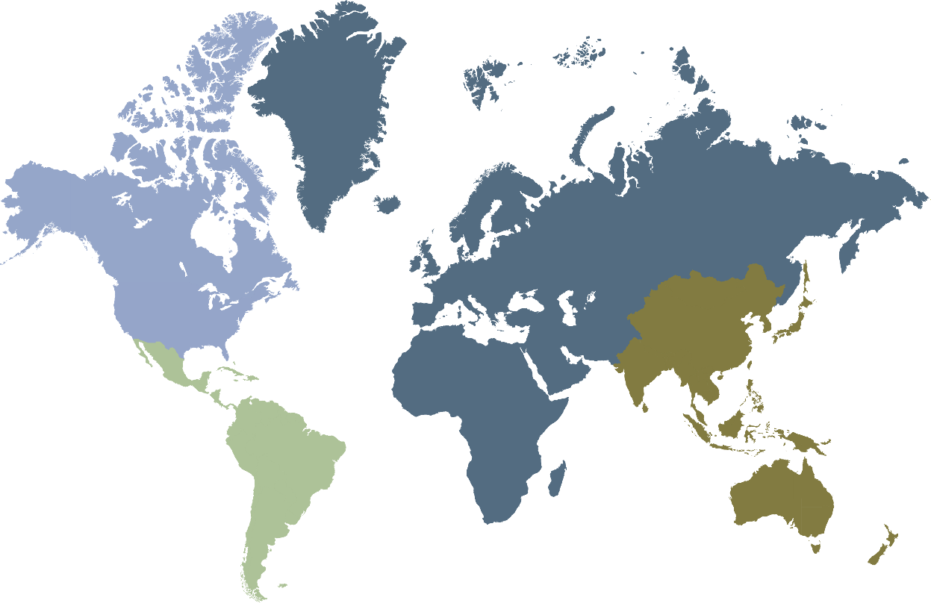
Global Engagement Through Local Chapters
Almost 40,000 members in 150 countries
REGION 1-7
130 chapters | 71 student chapters | 16,708 members
REGION 8
50 chapters | 84 student chapters | 5,587 members
REGION 9
36 chapters | 119 student chapters | 2,551 members
REGION 10
51 chapters | 198 student chapters | 12,645 members
267 Chapters and 472 Student Chapters: PES Chapters are a great way to plug in to the society in most parts of the world and get involved.
>50% of members are outside USA

Slide 5
PES Organizes Over 30 Conferences Per Year – Virtual in 2021
https://ieee-isgt.org/
https://www.powertech2021.com/
https://pes-gm.org/2021/
https://ieee-gtd.org/
https://ieee-powerafrica.org/
https://ieee-appeec.org/
Visit Conference website for latest information
https://ieee-isgt-europe.org/

Slide 6
By actively engaging in PES, you & your employees can stay up to date on the latest industry advances
Boost employees engagement by providing your professionals with:
Latest information about current trends and all aspects of the fast-changing industry
Industry insight through Power & Energy and Electrification magazines, technical reports and peer-reviewed journals
Compelling programs and peer engagement at our conferences and events
Platforms to tackle challenges via IEEE standards-development and technical committees
Opportunities to meet and collaborate via our local chapters and the global PES community
Get Involved. Email: pes@ieee.org

Slide 7
IEEE PES Corporate Engagement
Area of Collaboration
Benefits to Your Company
Membership | Full IEEE-PES membership includes access to the PES Resource Center, P&E Magazine, IEEE Electrification Magazine, and many more benefits
Conferences | Company’s PES Members enjoy special conference and event registration membership discounts
PES Resource Center | PES Resource Center contains a wealth of practical information that would help Company’s engineers and technologist. Company will receive free custom webinar training on using the Resource Center.
Technical Activities | PES can assist and train Company’s PES members on Technical Committee participation and processes.
Standards | Company’s PES members trained and engaged in developing guides and standards with a free custom webinar.
Get Involved. Email: pes@ieee.org

Slide 8
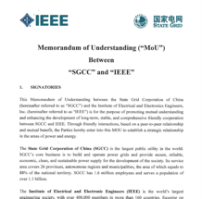
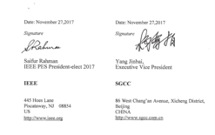
IEEE PES Corporate Engagement – Memorandum of Understanding
Corporations with MOUs
Bangalore Electricity Distribution Company Limited (BESCOM), India
Commonwealth Edison Company (ComEd)
ISO New England (ISO-NE)
Quanta Technology
State Grid Corporation of China (NGCC)
Vermont Electric Power Company (VELCO)
VELCO, Quanta Technology, IEEE PES, ComEd - MOU Signing
Universities with MOUs
Beijing Jiatong University (BJTU), China
Northeast Electric Power University (NEEPU), China
South China University of Technology (SCUT), China
Southwest Jiaotong University, China

Slide 9
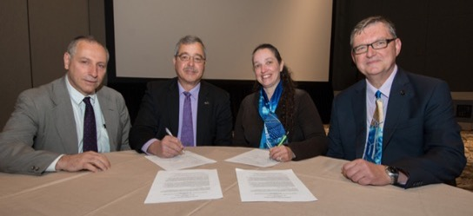
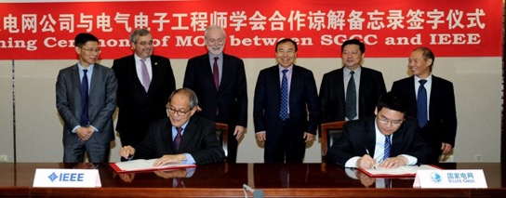
IEEE PES Corporate Engagement – Memorandum of Understanding
Government Agency MOUs
Ecuadorian Ministry of Electricity
US Department of Energy (DOE)
US Federal Energy Regulatory Commission (FERC)
North American Electric Reliability Corporation (NERC)
IEEE & the U.S. DoE sign MoU to address grid modernization challenges
Organizations – Agreements of Cooperation
International Council on Large Electric Systems (CIGRE)
Chinese Society of Electrical Engineering (CSEE)
Energy Systems Integration Group (ESIG)
North American Transmission Forum (NATF)
State Grid Corporation of China (SGCC)
IEEE PES & Smart Grid Corporation of China - MoU

Slide 10
PES Technical Community
Analytic Methods for Power Systems
Electric Machinery
Energy Development and Power Generation
Energy Storage and Stationary Battery
Insulated Conductors
Nuclear Power Engineering
Power System Communications and Cybersecurity
Power System Dynamic Performance
Power System Instrumentation and Measurements
Power System Operations, Planning and Economics
Power System Planning and Implementation
Power System Relaying and Control
Smart Buildings, Loads and Customer Systems
Substations Committee
Surge Protective Devices
Switchgear
Transformers
Transmission and Distribution
Coordinating Committees:
Intelligent Grid & Emerging Technologies
Marine Systems
Wind and Solar Power

Slide 11
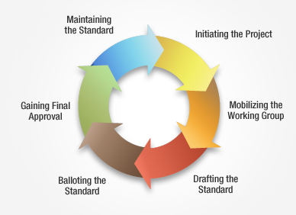
IEEE Standards Development Lifecycle
IEEE Standards are developed using a time-tested, effective and trusted process that is easily explained in a six stage lifecycle diagram
45%+ IEEE Standards are Created by PES Technical Committees
Get Involved. Visit: standards.ieee.org/getinvolved
Notes:
As of 26 January 2021
Active/Published Standards: 553 PES stds out of 1225 total SA Stds -- 45%
Active PARs (projects): 354 PES PARs out of 948 total SA PARs -- 37% of the PARs

Slide 12
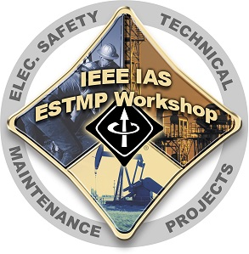
Stay Technically Proficient with PES
PES is deploying significant resources for training and lifelong learning activities for our practicing engineer members. Many resources are eligible for CEUs PDHs!
Online Webinars
& Tutorials
On-site Training & Workshops
Practice-Oriented Technical Journal
Plain Talk Basic Courses for Industry Novice

Slide 13
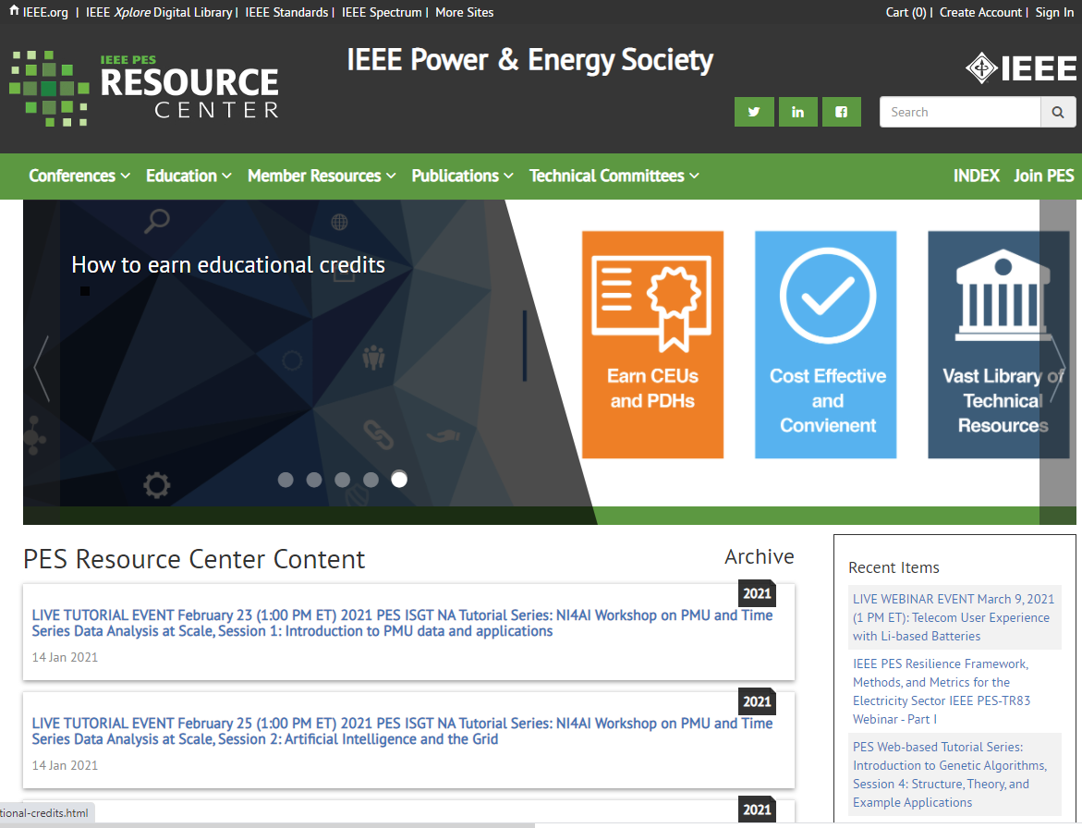
Everything You Need IN ONE PLACE
Visit the IEEE PES Resource Center
The IEEE PES Resource Center is the most extensive library in the world devoted exclusively to the power and energy industry. You don’t have to be a PES member to access the Resource Center’s vast array of industry oriented content, which is available to assist in your research, presentations, or academic programs, and benefit your professional development!
resourcecenter.ieee.pes.org
Earn Continuing Education Credits
PES MEMBER ACCESS
NON-PES MEMBER ACCESS
Register for live educational events
Watch Video Tutorials & Archived Webinars
Update Your License with CEU/PDH credits
Download Full PES Magazines
Access Conference Videos & Presentations
Download Complete Technical Reports
Most materials in the PES Resource Center are free to society members – an important member benefit.
Discounted prices, for IEEE members, are listed for each product. Non-members also have access to all the products on the IEEE PES Resource Center.

Slide 14
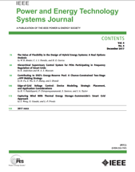
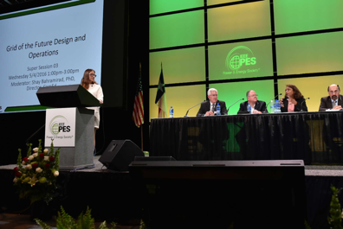
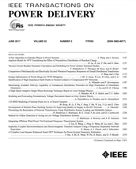
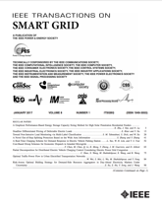
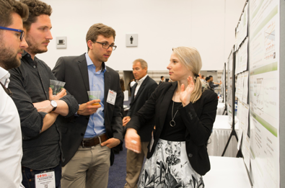
Engaging Academic Community
Publishing Research
Sharing Ideas with Peers
Posters Presentations
Standards Development

Slide 15
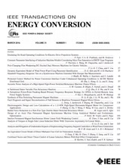
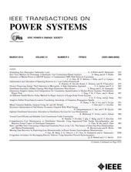
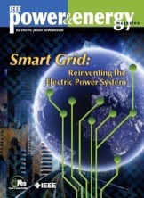
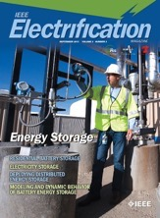
Publications
Two award-winning magazines, Power & Energy and Electrification
Spanish P&E Magazine, Transactions, and an open-access journal (OAJPE)
Latest PES updates shared in monthly eNews, PES eBulletin, Trending Technical topics & other email announcements
IEEE Open Access Journal of Power & Energy

Slide 16
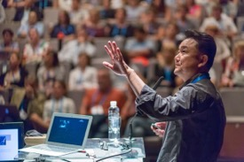
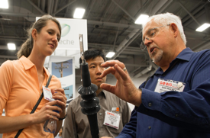
IEEE PES Membership Diversity
Diverse Technical Backgrounds
Utilities, Municipalities and RTOs/ISOs
Academics and Research
Equipment Manufacturers and System Suppliers
Government and Regulatory
Testing Labs, Consulting and more
Attracting wide audiences by creating and implementing new technical ideas and applying best practices through output and initiatives

Slide 17
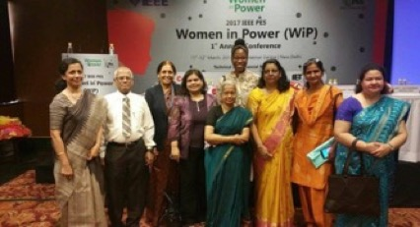
Developing Women in Power
Fostering a more diverse leadership by supporting the career advancement, networking and education of women in the energy industry
Get Involved. Visit: pes-women-in-power.org

Slide 18
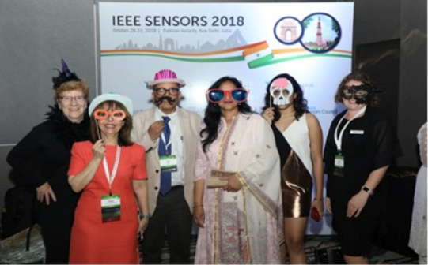
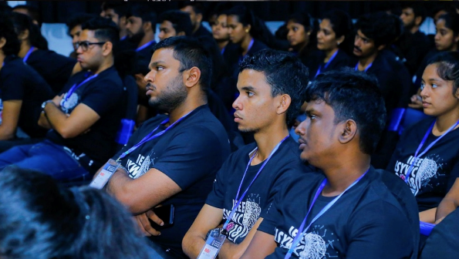
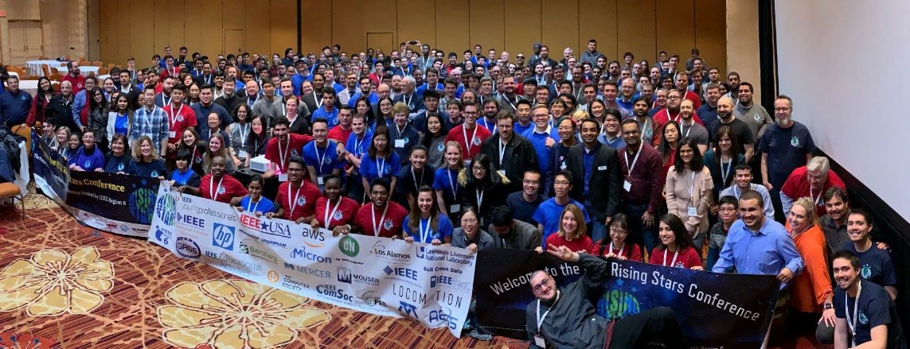
Mentoring Young Professionals
Over 6,200 PES Young Professionals worldwide, and growing!
Helping young professionals evaluate their career goals, polish their professional image, and create the building blocks of a lifelong and diverse professional network
Get Involved. Visit: sites.ieee.org/pes-yp

Slide 19
Building a Sustainable Workforce
Solid impact to date. But additional support (both financial & internships) is needed
Addressing the power and energy workforce shortage in USA, Canada, Puerto Rico, India & Italy
Goal: distribute as many scholarships as possible to attract top EE students into power & energy careers
Get Involved. Donate Online. Visit: ee-scholarship.org

Slide 20
Collaborating to encourage the successful rollout of technologically advanced, environment-friendly and secure smart-grid networks around the world.
Set the Global Standard via Collaboration
Provide Education, Research and Innovation
Expand Global Reach via Marketing
Get Involved. Visit: smartgrid.ieee.org

Slide 21
Brings together various IEEE’s technical societies and organizations to advance the state of the art for smart city technologies for the benefit of society
Serves as neutral broker of information amongst industry, academic, and government stakeholders.
Smart Buildings
Smart Living
Smart Transportation
Smart Energy
Smart Communications
Smart Networks
Self-Aware Digital Hub
Environmental Awareness
Get Involved. Visit: smartcities.ieee.org

Slide 22
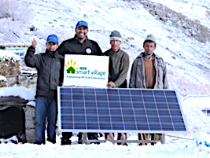
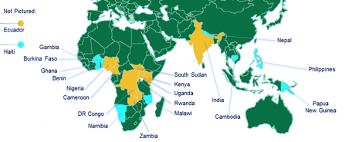
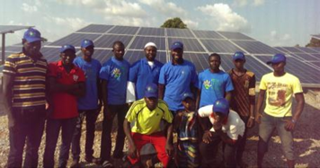
An institute-wide humanitarian program supported by PES
Signature program of the IEEE Foundation.
Dramatically bettering the lives of more than 100,000 off-grid villagers with light and modest power
Get Involved. Visit: ieee-smart-village.org

Slide 23
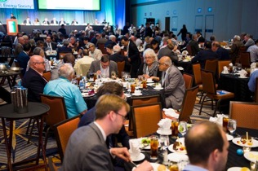
IEEE PES Awards
Provides member recognition for important technical, educational and service contributions
Recipients recognized at Awards Gala during annual PES General Meeting
Learn More. Visit: ieee-pes.org/pes-communities/awards

Slide 24
Thank You!
Get Involved. Visit: ieee-pes.org

